Slide 1
The Evergreen Project
Be captivated by the experience.
Presented by: Cheyne Jackson

Slide 2
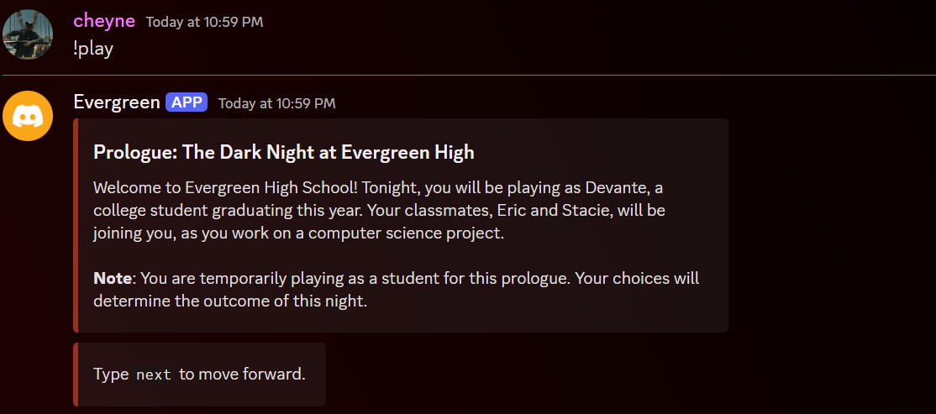
What is Evergreen?
A discord bot that simulates a thriller themed text-based adventure.
Players play as a student trying to save his life but will play as the detective solving the mystery in future chapters.

